Slide 1
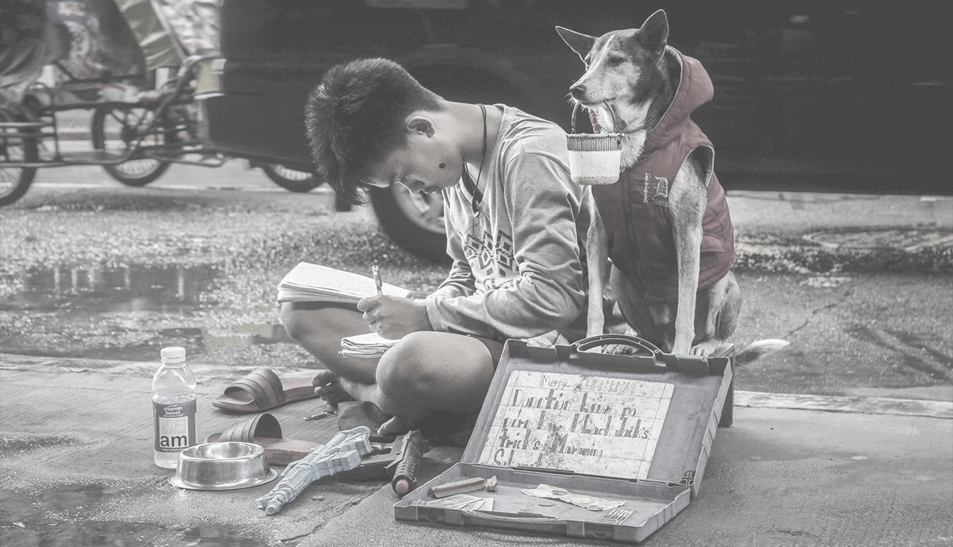

Analysis
of academic
Success
According
to the test
“Saber pro”
using
decision
trees

Slide 2
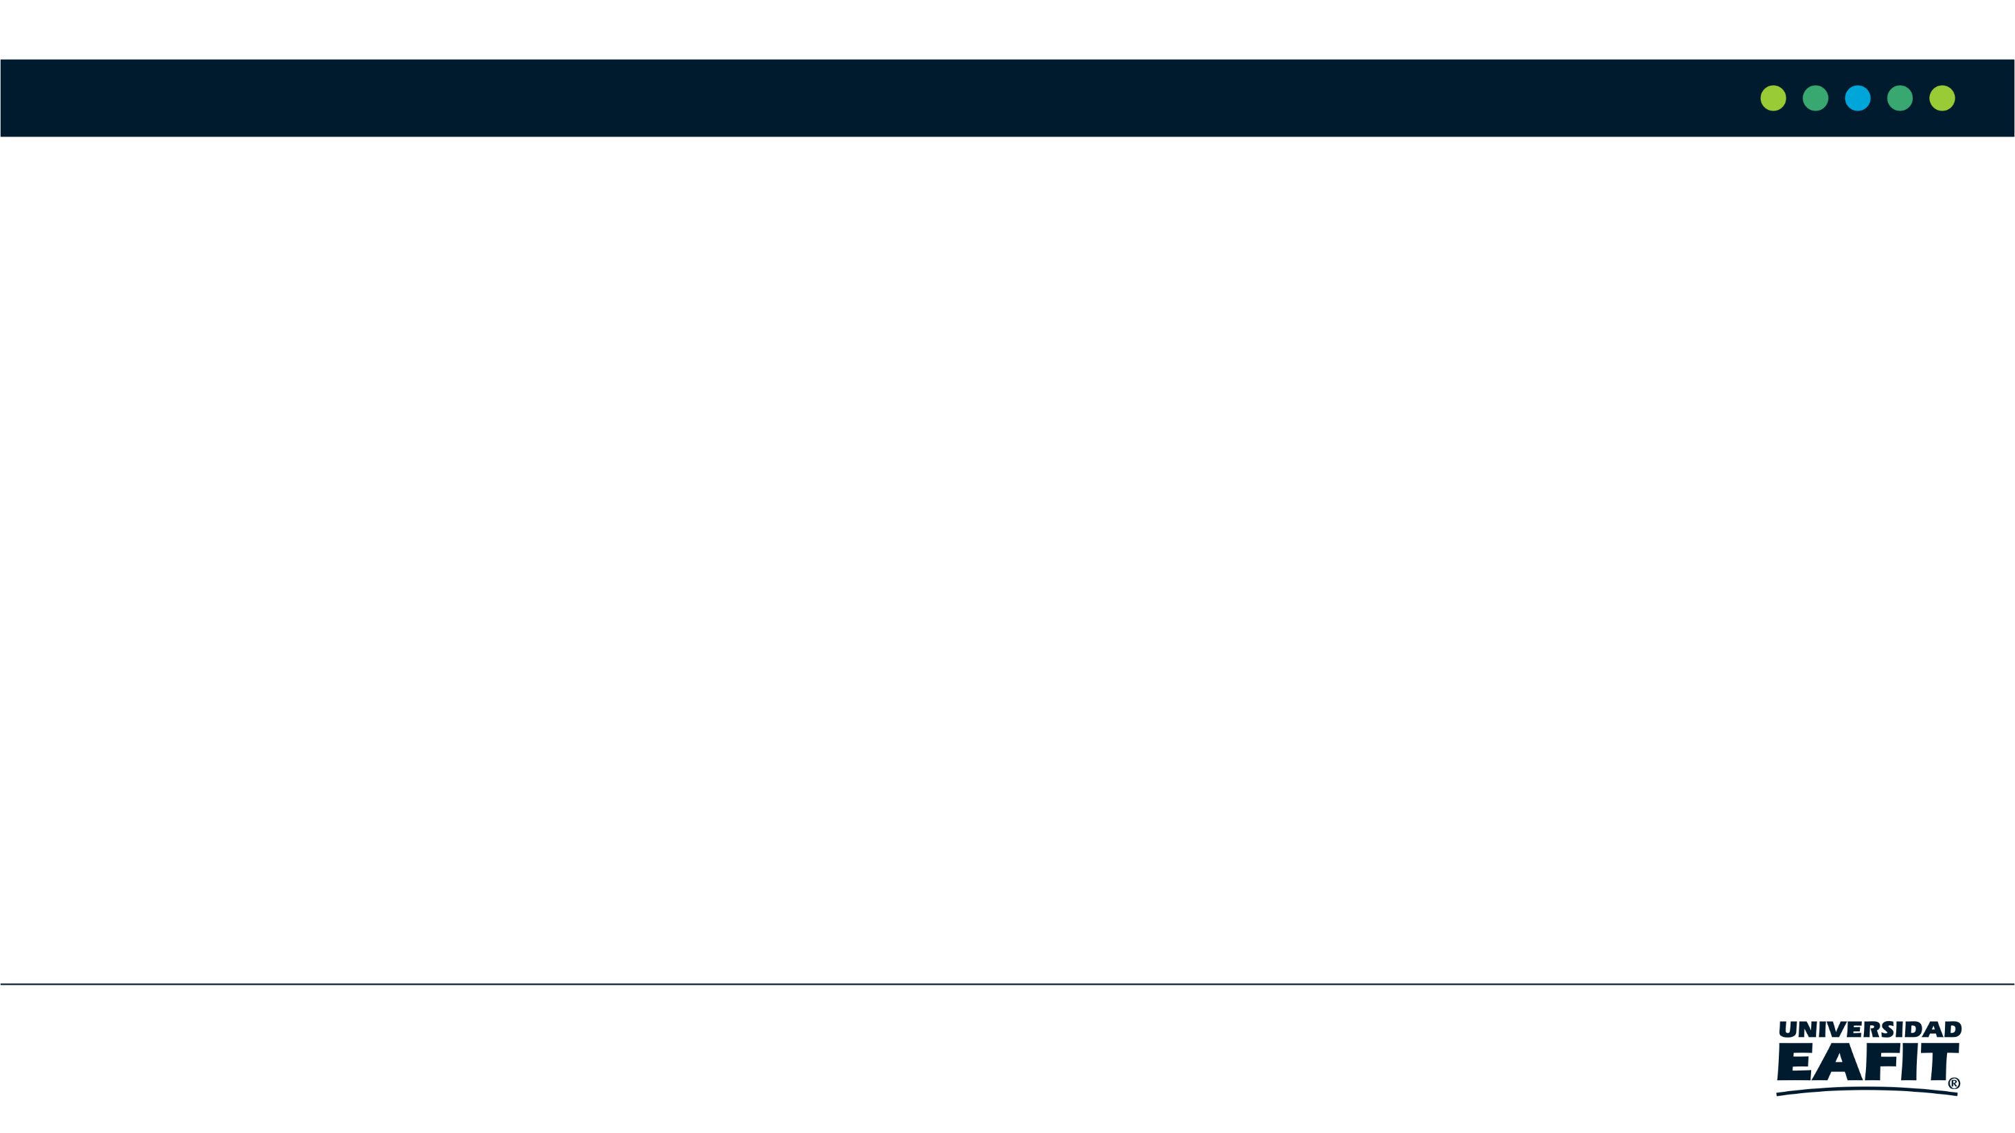
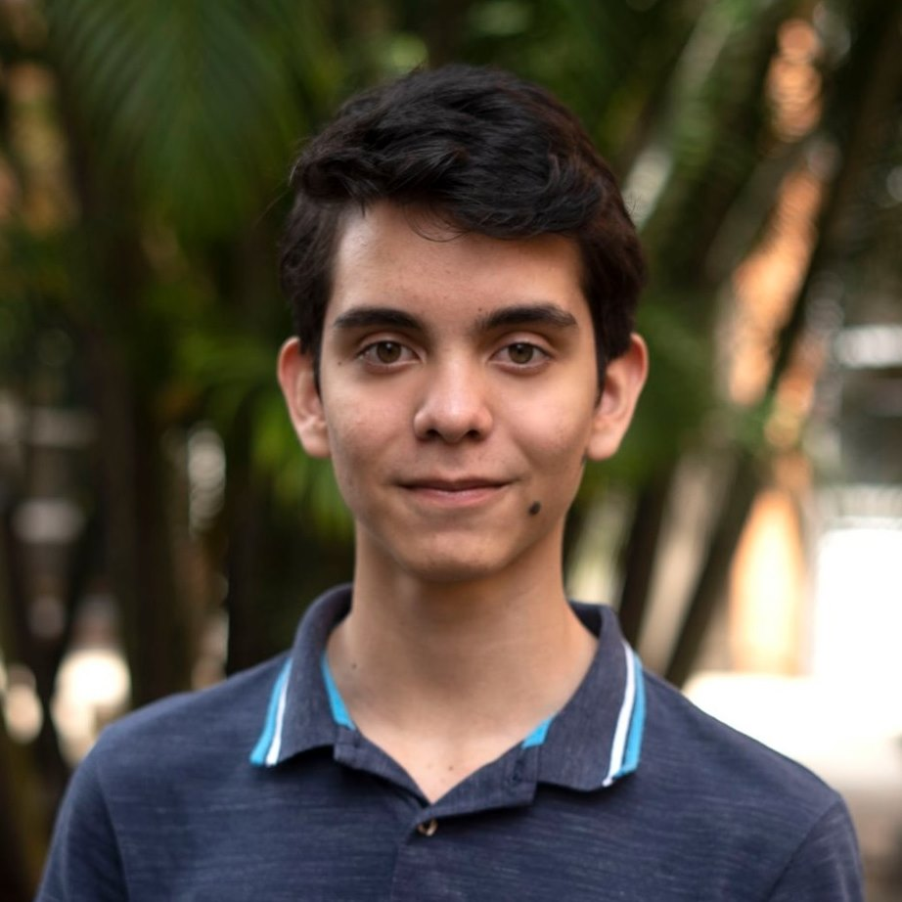

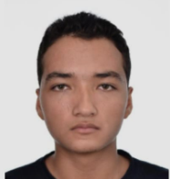
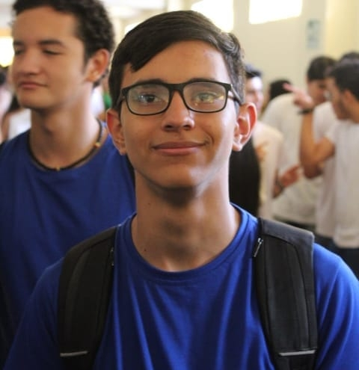

Team Presentation
Juan David Echeverri Villada
Octavio Vásquez Zapata
Miguel Correa
Mauricio
Toro
https://github.com/Juanda0/ST0245-001/tree/master/proyecto

Slide 3
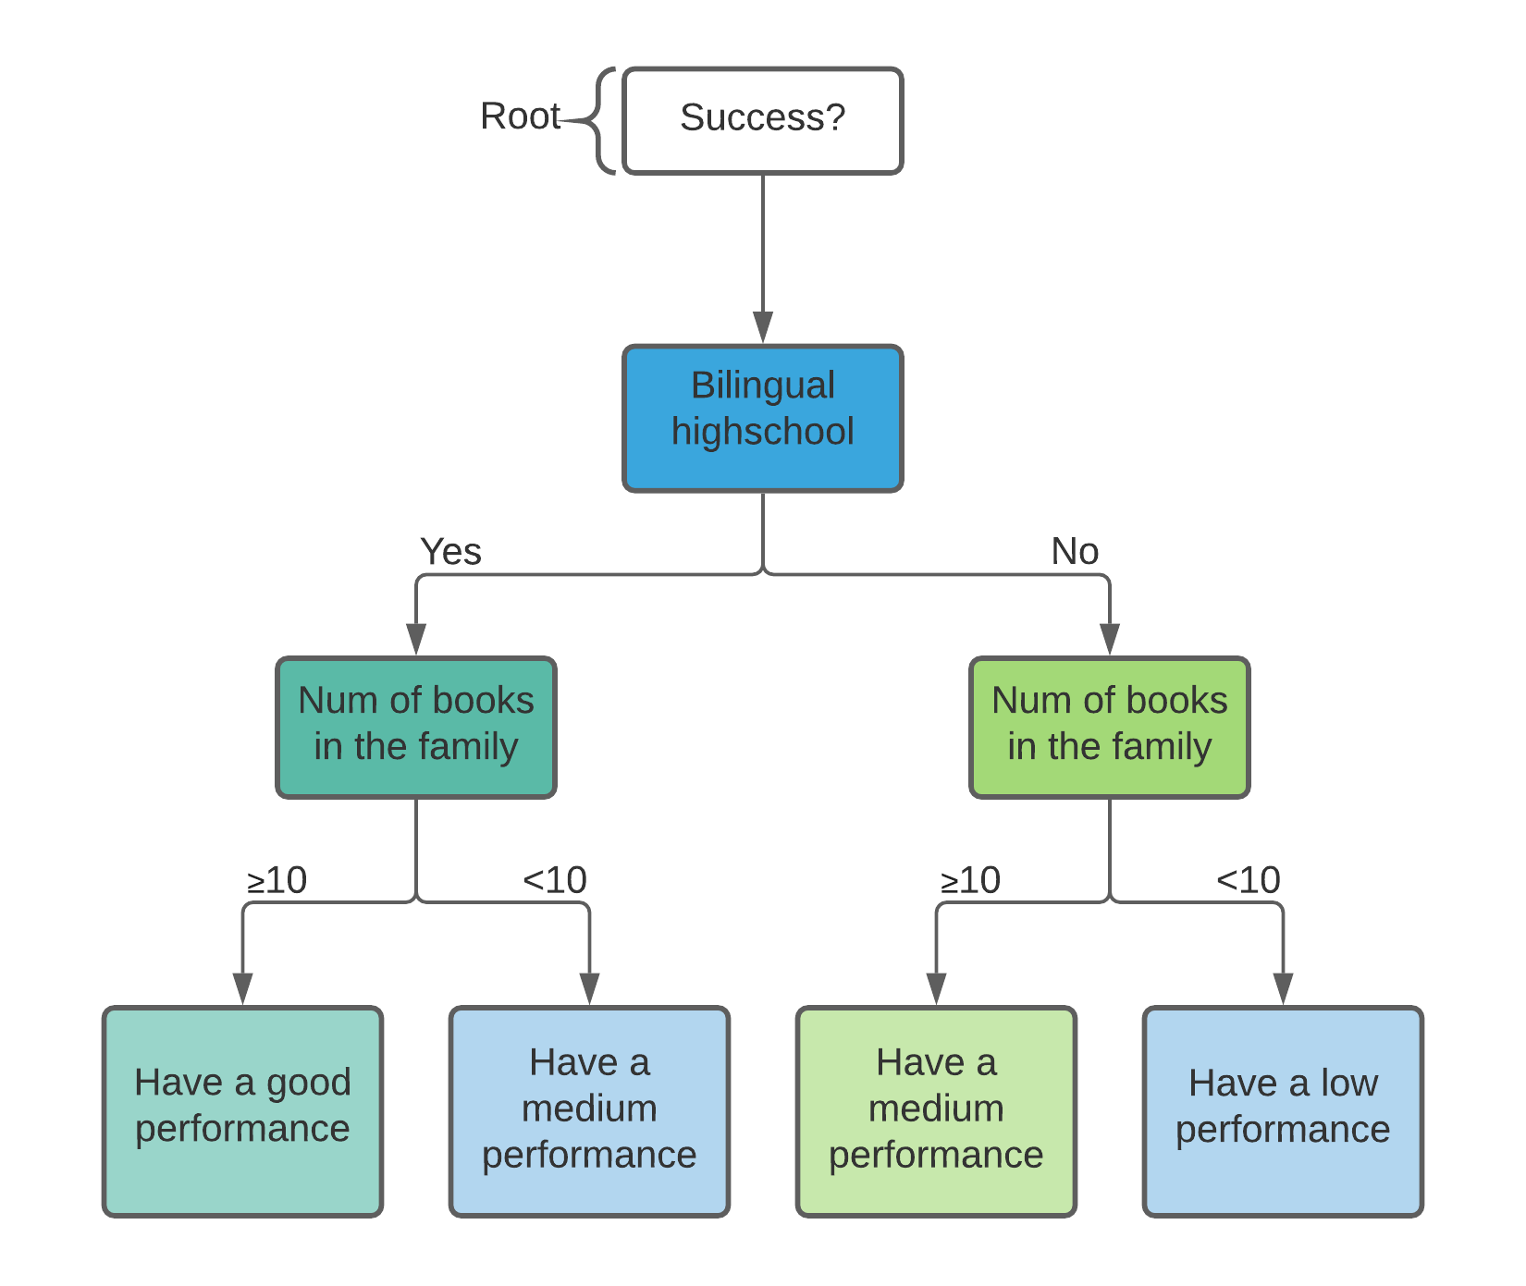

Algorithm Design
The algorithm is designed to filter the datasets according to the conditions that the student matches. It is the responsible to build up the decision tree according to the given parameters.
EL HERALDO(2019), ICFES. https://bit.ly/3iAKy9H

Slide 4
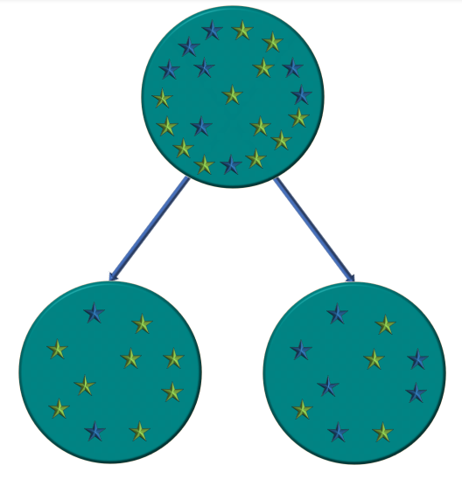
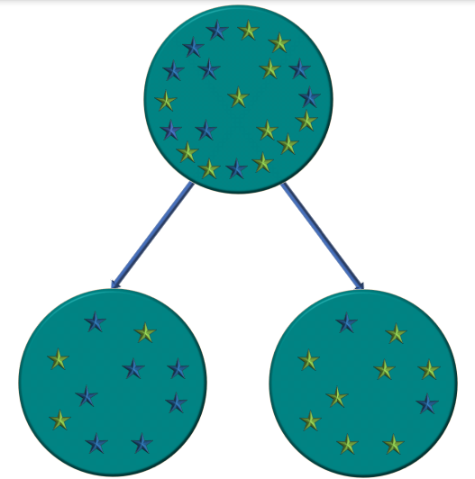
Node Splitting
Took preparation course “Saber 11” English average
Successful students
Other students
No
Yes
< 53
≥ 53
In this node, the split condition is whether or not the student took a preparation course. for this case, left Gini impurity is 0.2493 and each student have the 85,40 % of success, while in the right Gini impurity is 0,4847 and each student have the 41,24 % of success, and weighted Gini impurity is 0,2787 (this is the condition that reduces Gini impurity the most)
in this node, the split condition is whether or not the student got a grade over the average in the English section in “Saber 11”. for this case, left Gini impurity is 0,4331 and each student have the 31,71 % of success, while in the right Gini impurity is 0,2954 and each student have the 81,98 % of success, and weighted Gini impurity is 0,3831
*For the purpose of improving the quality of the data, we decided to ignore the students who did not answered the question

Slide 5

Complete this slide
For the third deliverable
Algorithm Complexity
Keep this title
Create the table in Powerpoint. Do not copy pixelated screenshots from the technical report please!
 | Time Complexity | Memory Complexity
Training the model | O(N²*M*2^{M}) | O(N*M*2^{M})
Testing the Model | O(N*M) | O(1)
Time and memory complexity of the (In this semester, one could be CART, ID3, C4.5… please choose) algorithm. (Please explain what do N and M mean in this problem. PLEASE DO IT!
Explain the tables in your
own words
Include another HD picture related to the example that you modeled in the decision tree

Slide 6
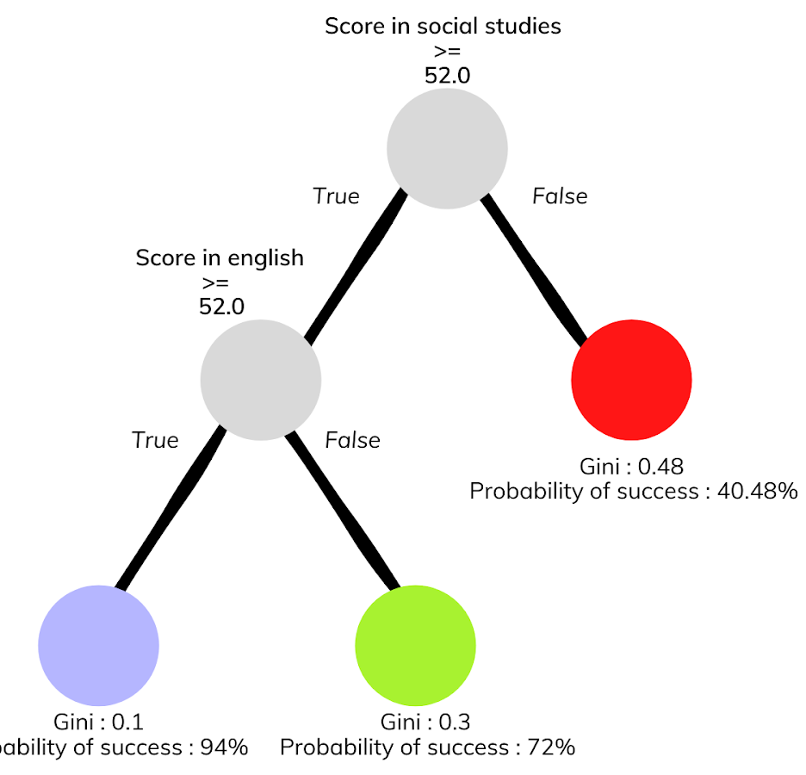



Complete this slide
For the third deliverable
Decision-Tree Model
Keep this title
Create the Figure in Powerpoint. Do not copy pixelated screenshots from the technical report please!
Most Relevant Features
Social Studies
English
Gender
A binary decision tree to predict Saber Pro scores based on the results of Saber 11. Violet nodes represent those with a high probability of success, green medium probability and red a low probability of success.
Use an icon for each feature!
Is it ethical to make a model that predicts academic success based on gender?
Explain the Figures in your
own words

Slide 7

Complete this slide
For the third deliverable
Evaluation Metrics
Keep this title
Use vectorized figures to
explain the algorithm the evaluation metrics, so they are not pixeled like mines
Use these
Colors for
Your figures
Explain Accuracy too…
In the same manner
If possible, avoid equations for simple concepts that can be
explained through diagrams

Slide 8
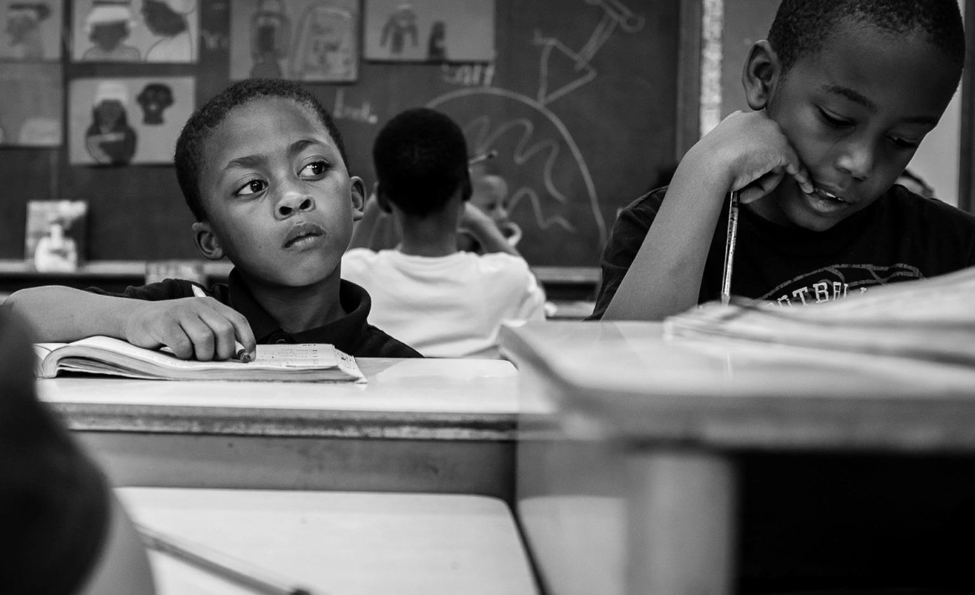
Complete this slide
For the third deliverable
Evaluation Metrics
Keep this title
Create the table in Powerpoint. Do not copy pixelated screenshots from the technical report please!
 | Training data set | Testing data set
Accuracy | 0.8 | 0.62
Precision | 0.6 | 0.55
Recall | 0.76 | 0.61
Evaluation metrics using a training dataset of 135,000 students and test dataset of 45,000 students.
Include another HD picture related to the example that you modeled in the decision tree
Explain the tables in your
own words

Slide 9


Complete this slide
For the third deliverable
Time and Memory Consumption
Keep this title
Create the plots in Excel. Do not copy pixelated screenshots from the technical report please!
Time Consumption
Memory Consumption

Slide 10
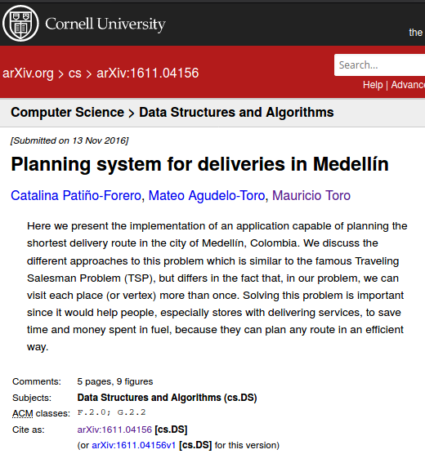
Complete this slide
For the third deliverable
Report Accepted on arXiv
Keep this title
Include the citation of the report in arXiv and link
C. Patiño-Forero, M. Agudelo-Toro, and M. Toro. Planning system for deliveries in Medellín. ArXiv e-prints, Nov. 2016. Available at: https://arxiv.org/abs/1611.04156
Include a screenshot

Slide 11
Complete this slide
For the third deliverable
Say thank you for listening!
THANK YOU!

